Slide 1





By:
K. Ajay Kumar

Slide 2


INDEX
INTRODUCTION
FIRST GENERATION OF COMPUTER
SECOND GENERATION OF COMPUTER
THIRD GENERATION OF COMPUTER
FOURTH GENERATION OF COMPUTER
FIFTH GENERATION OF COMPUTER
REFERENCE

Slide 3

INTRODUCTION
The history of computer development is often referred to in reference to the different generations of computing devices. Each generation of computer is characterized by a major technological development that fundamentally changed the way computers operate, resulting in increasingly smaller, cheaper, more powerful and more efficient and reliable devices.

Slide 4
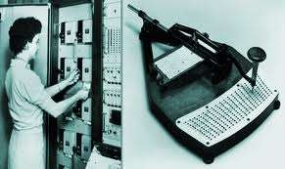
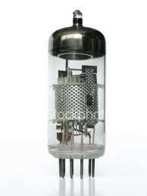
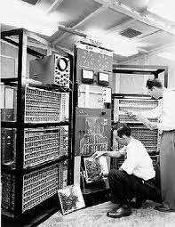
First Generation - 1940-1956: Vacuum Tubes
Used vacuum tubes for circuitry, magnetic drums for memory, and were often enormous, taking up entire rooms.
Very expensive , consumed great deal of electricity, generated a lot of heat, which was often the cause of malfunctions.
Relied on machine language to perform operations, could solve one problem at a time.
Input was based on punched cards and paper tape, and output was displayed on printouts.
UNIVAC and ENIAC computers are examples of first- generation computing devices.

Slide 5
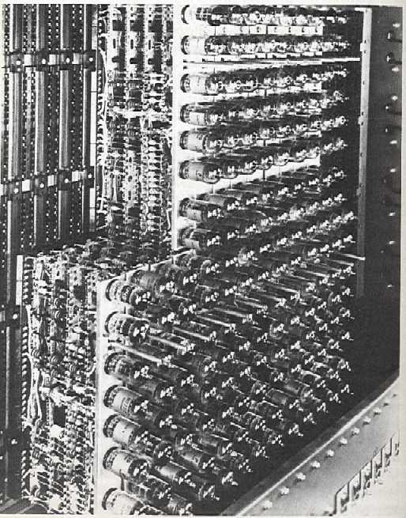
ENIAC (Electronic Numeric Integrator And Calculator ) (UNIVAC ) Universal Automatic Computer

Slide 6
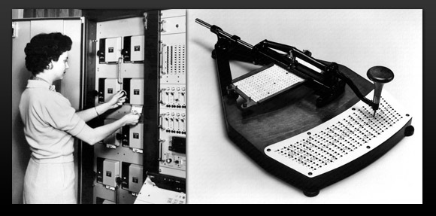

Slide 7
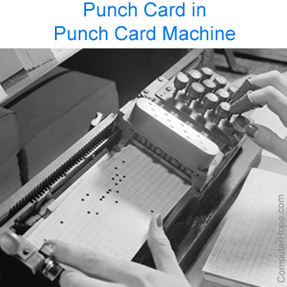

Slide 8
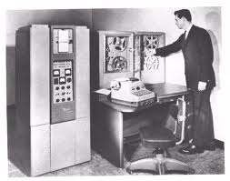
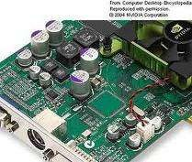
Second Generation - 1956-1963: Transistors
Transistors replaced vacuum tubes allowing computers to become smaller, faster, cheaper, more energy-efficient and more reliable than their first-generation predecessors.
Still relied on punched cards for input and printouts for output.
Second-generation computers moved from cryptic binary machine language to symbolic, or assembly, languages, which allowed programmers to specify
instructions in words.
High-level programming languages like COBOL and FORTRAN were used.

Slide 9
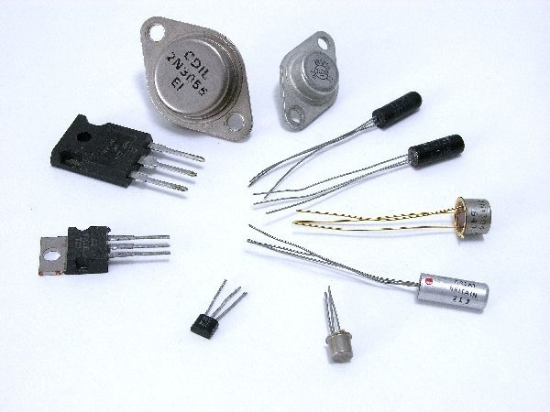

Slide 10
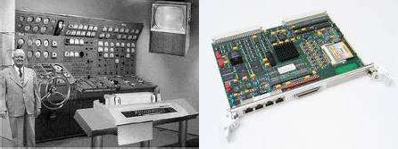
Third Generation - 1964-1971: Integrated Circuits
Integrated circuit was used
Transistors were miniaturized and placed on silicon chips, called semiconductors, which increased the speed and efficiency of computers.
Instead of punched cards and printouts, users interacted through keyboards and monitors and interfaced with an operating system, which allowed the device to run many different applications at one time with a central program that monitored the memory.
Computers for the first time became accessible to a mass audience because they were smaller and cheaper
than their predecessors.

Slide 11
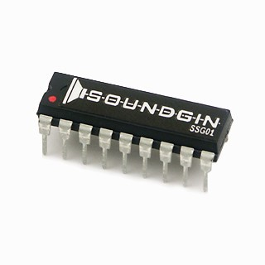
Integrated Circuits are transistors, resistors, and capacitors integrated together into a single “chip”

Slide 12
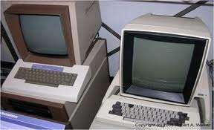
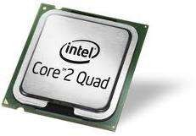
Fourth Generation - 1971-Present:
Microprocessors
Microprocessor were used
What in the first generation filled an entire room could now fit in the palm of the hand
In 1981 IBM introduced its first computer for the home user, and in 1984 Apple introduced the Macintosh.
As these small computers became more powerful, they could be linked together to form networks, which eventually led to the development of the Internet.
Fourth generation computers also saw the development of GUIs, the mouse and Hand held devices.

Slide 13
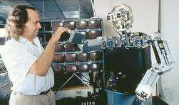
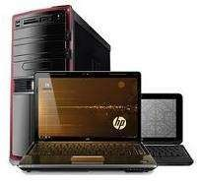
Fifth Generation - Present and Beyond: Artificial Intelligence
Fifth generation computing devices, based on artificial intelligence, are still in development, though there are some applications, such as voice recognition, that are being used today.
The use of parallel processing and superconductors is helping to make artificial intelligence a reality.
Quantum computation and molecular and nanotechnology will radically change the face of computers in years to come.
The goal of fifth-generation computing is to develop devices that respond to natural language input and are capable of learning and self-organization.

Slide 14
REFERENCE
www.library.thinkquest.org
www.datahub.blog.co.in
www.google.com

Slide 15
THANK YOU

